Slide 1
Carl Bloch Exhibit
BYU-Idaho Center Gallery
Notes:
Welcome to the Carl Bloch BYU-Idaho exhibit and audiovisual tour. This presentation combines the paintings of renowned 19th century artist Carl Bloch with scripture from the gospels of Matthew, Mark, Luke, and John, to commemorate the life and ministry of our Savior Jesus Christ.

Slide 2
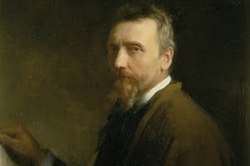
Carl Bloch
Notes:
A talented painter, Carl Heinrich Bloch devoted much of his artistic career depicting the life of the Savior. He is widely recognized as the greatest artist to do so, and many other artists’ portrayals are based on his interpretations.

Slide 3
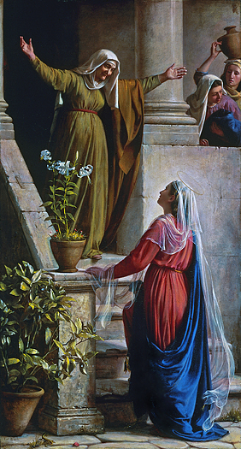
Mary and Elizabeth
1
Notes:
As Mary arrived to live with her cousin, Elizabeth, it is recorded that “when Elisabeth heard the salutation of Mary, the babe leaped in her womb; and Elisabeth was filled with the Holy Ghost...” In their full time, Mary and Elizabeth gave birth to two of the greatest men in history: Jesus Christ, the redeemer of all mankind, and John the Baptist, the prophet who would precede Him.

Slide 4
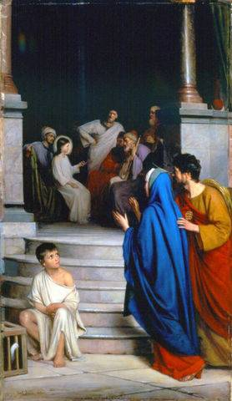
Teaching in the Temple
2
Notes:
Even at a young age the Savior showed remarkable wisdom. Unbeknown to Joseph and Mary, the boy Jesus had tarried in Jerusalem, and “...it came to pass, that after three days they found him in the temple, sitting in the midst of the doctors, both hearing them, and asking them questions. And all that heard him were astonished at his understanding and answers.” (Luke 2:46-47)

Slide 5
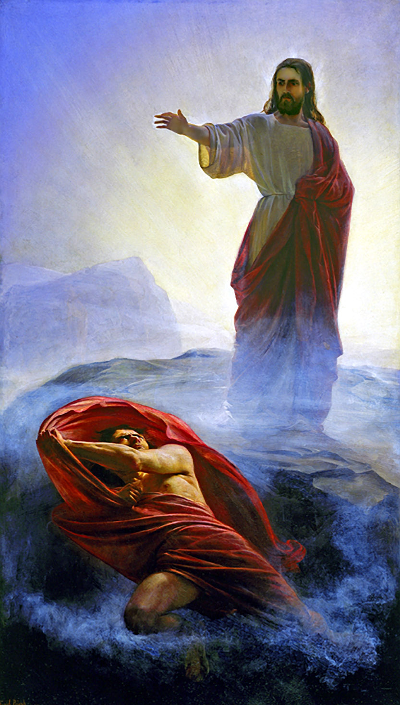
Denying Satan
3
Notes:
“Then saith Jesus unto him, Get thee hence, Satan: for it is written, Thou shalt worship the Lord thy God, and him only shalt thou serve.” (Matthew 4:10)
Despite great physical fatigue, the Savior showed spiritual strength in resisting the Tempter. Unmoved by his power, the Lord casts Satan from his presence.

Slide 6
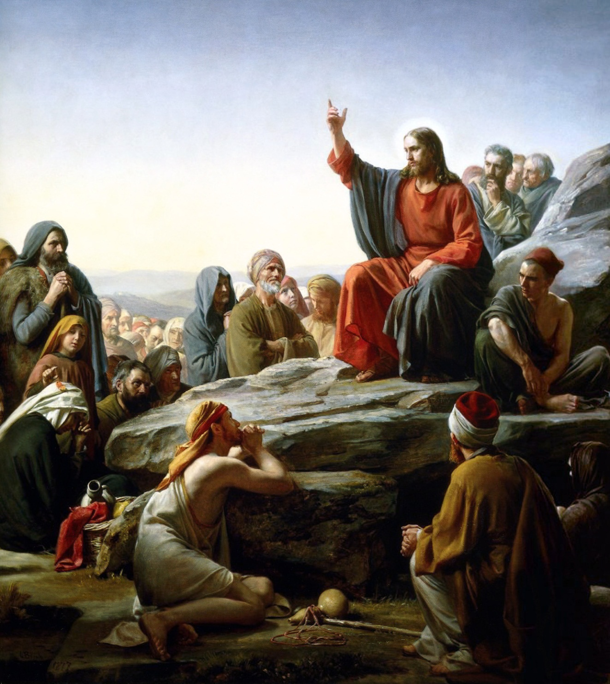
Sermon on the Mount
4
Notes:
“And seeing the multitudes, he went up into a mountain: and when he was set, his disciples came unto him: And he opened his mouth and taught them...” (Matthew 5: 1-2)
Considered one of the greatest discourses of all time, the Sermon on the Mount ushered in a new era of doctrine and eternal principles for the Children of Israel and the world.

Slide 7
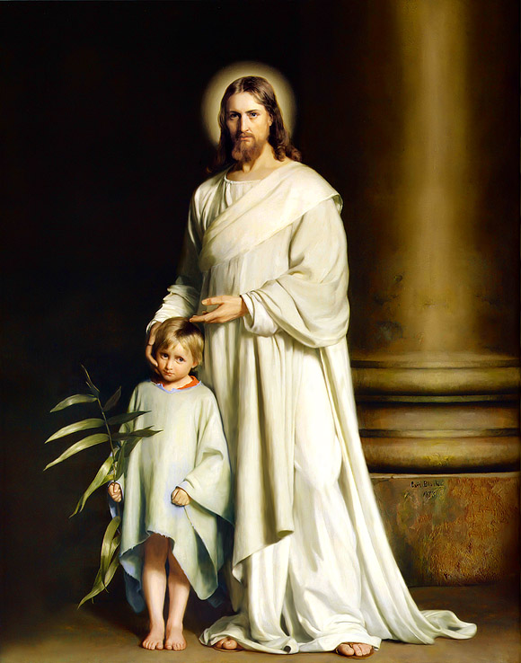
Christ and the Young Child
5
Notes:
“And Jesus called a little child unto him, and set him in the midst of them, And said, Verily I say unto you, Except ye be converted, and become as little children, ye shall not enter into the kingdom of heaven. Whosoever shall humble himself as this little child, the same is greatest in the kingdom of heaven.” (Matthew 18:2-4)
In one of the most touching moments in all of scripture, the Lord Jesus Christ teaches a simple yet profound truth through the means of a child.

Slide 8
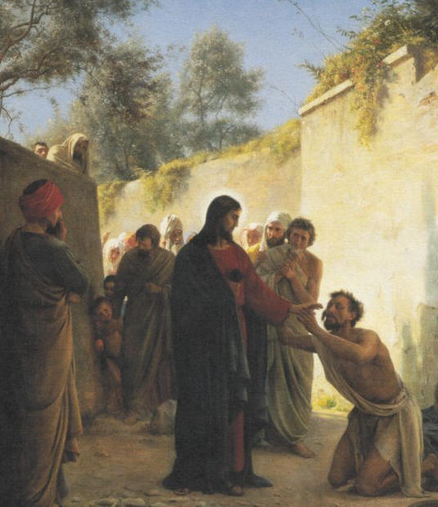
Healing the Blind Man
6
Notes:
“And Jesus answered and said unto him, What wilt thou that I should do unto thee? The blind man said unto him, Lord, that I might receive my sight. And Jesus said unto him, Go thy way, thy faith hath made thee whole. And immediately he received his sight, and followed Jesus in the way.” (Mark 10: 51-52)
Among the Savior’s many miracles, the healing of the blind stands among the most memorable and symbolic. That the Lord could restore sight to the blind shows his power and mercy to those who turn to Him.

Slide 9
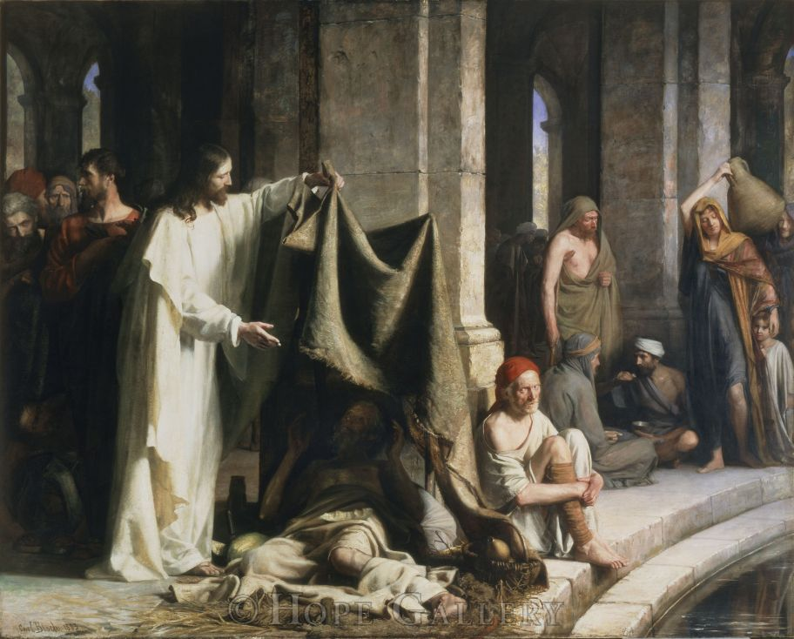
Healing at the Pool of Bethseda
7
Notes:
At the edge of the Pool of Bethesda, where gathered many sick and afflicted. John wrote that one of these men spoke unto the Savior and received a miracle from him., “Sir, I have no man, when the water is troubled, to put me into the pool: but while I am coming, another steppeth down before me. Jesus saith unto him, Rise, take up thy bed, and walk. And immediately the man was made whole, and took up his bed, and walked” (John 5:7-9).

Slide 10
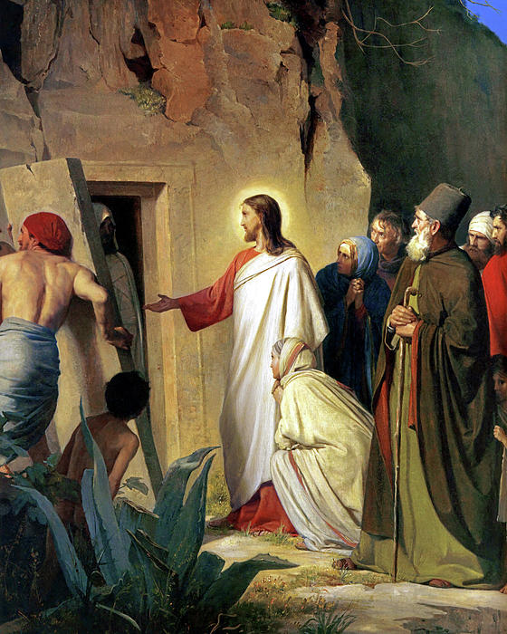
Raising of Lazarus
8
Notes:
Among Christ’s greatest miracles was this: after Lazarus had been dead for four days, Christ came to the tomb and, according to the words of John, “he cried with a loud voice,Lazarus, come forth. And he that was dead came forth, bound hand and foot with graveclothes: and his face was bound about with a napkin. Jesus saith unto them, Loose him, and let him go” (John 11:43-44).

Slide 11
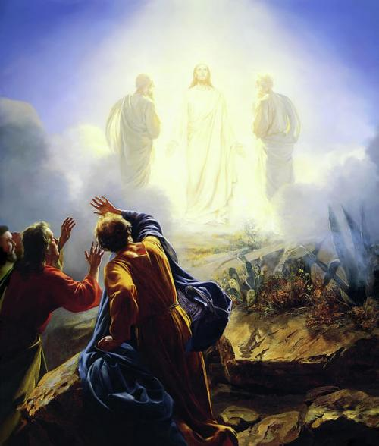
Transfiguration of Christ
9
Notes:
Few mortals have ever seen Christ in all his glory and majesty. Peter, James, and John beheld this glory on what is now called the Mount of Transfiguration. Matthew records, “Jesus taketh . . . [them] and bringeth them up into an high mountain apart, And was transfigured before them: and his face did shine as the sun, and his raiment was white as the light. And, behold, there appeared unto them Moses and Elias talking with him” (Matt 17:1-3).

Slide 12
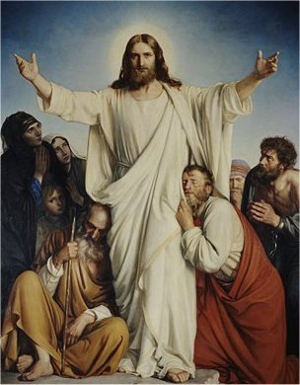
The Consolator
10
Notes:
Throughout his ministry Christ was followed by many people, and in eternal unconditional love he healed and blessed all who had faith in him. The apostle Mark wrote, “And whithersoever he entered, into villages, or cities, or country, they laid the sick in the streets, and besought him that they might touch if it were but the border of his garment: and as many as touched him were made whole” (Mark 6:56).

Slide 13
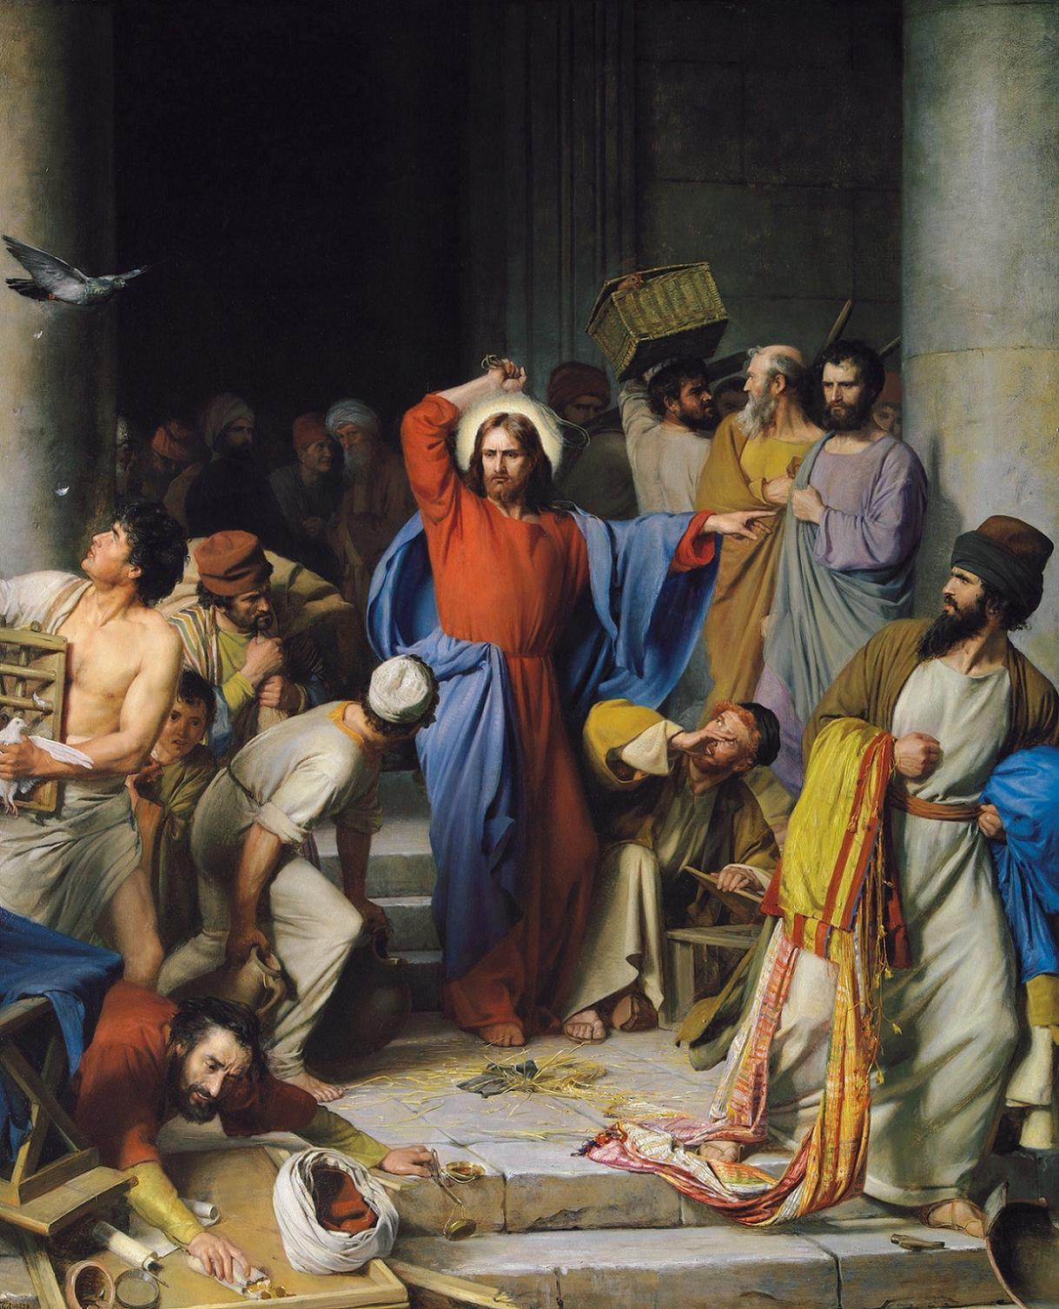
Cleansing the Temple
11
Notes:
Finding that money-changers had overtaken the temple at Jerusalem, Christ fashioned a scourge of small cords and drove them from the holy place, saying, “It is written, My house shall be called the house of prayer; but ye have made it a den of thieves.” He poured out the changers’ money and overthrew their tables, commanding them to “make not my Father’s house an house of merchandise.”

Slide 14
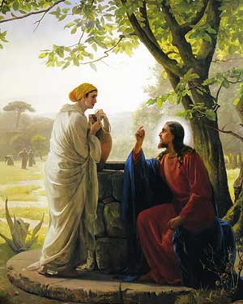
The Woman at the Well
12
Notes:
A woman of Samaria met Christ at a well. When he asked her to give him water, she wondered at the request, as Jews had no dealings with Samarians. He told her, as we read in John, that “Whosoever drinketh of this water shall thirst again: But whosoever drinketh of the water that I have shall never thirst; but the water that I shall give him shall be in him a well of water springing up into everlasting life” (John 4:13-4).

Slide 15
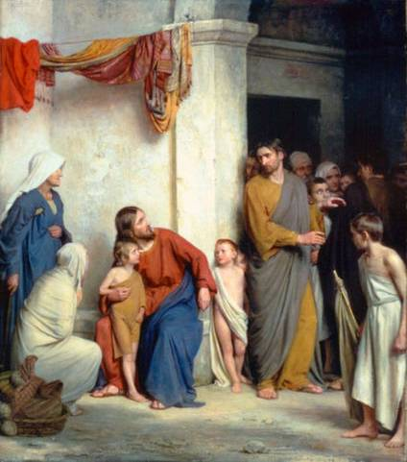
Christ and the Children
13
Notes:
“But Jesus called them unto him, and said, Suffer little children to come unto me, and forbid them not: for of such is the kingdom of God.” (Luke 18:16)

Slide 16
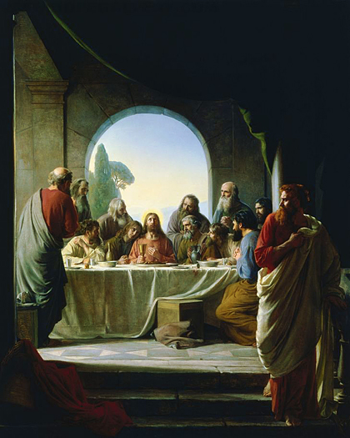
The Last Supper
14
Notes:
Shortly before his death, Christ gathered his apostles and taught them how to partake of the Sacrament. Luke records how he did this. “And he took bread, and gave thanks, and brake it, and gave unto them, saying, This is my body which is given for you: this do in remembrance of me. Likewise also the cup after supper, saying, This cup is the new testament in my blood, which is shed for you (Luke 22 19-20).

Slide 17
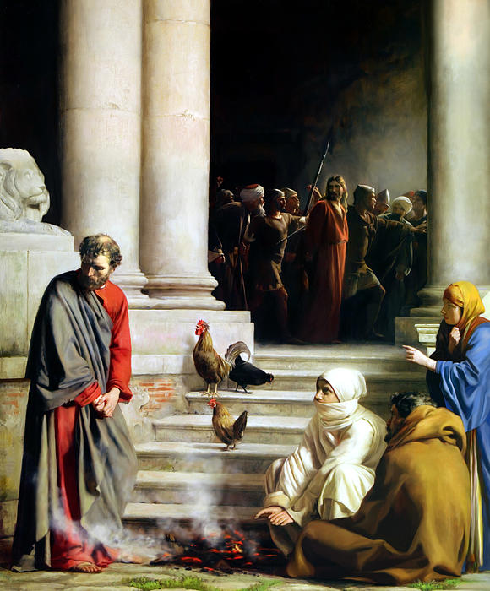
Peter’s Denial
15
Notes:
While Christ was being tried, three people commented that Peter had known and been with Christ. He denied knowing Christ each time. When he realized what he had done, despite his assurance to Christ that he would do no such act, Luke writes that “Peter went out, and wept bitterly” (Luke 22:62).

Slide 18
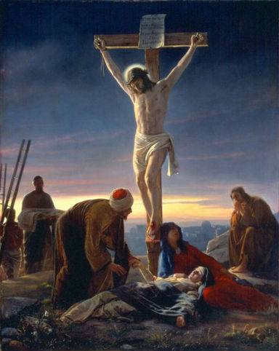
The Crucifixion
16
Notes:
Of the crucifixion of Christ, Mark records, “And at the ninth hour Jesus cried with a loud voice, saying . . . My God, my God, why hast thou forsaken me?” (Mark 15:34). Jeffrey R. Holland of the Quorum of the Twelve Apostles explained, “With all the conviction of my soul I testify that He did please His Father perfectly and that a perfect Father did not forsake His Son in that hour. Nevertheless, that the supreme sacrifice of His Son might be as complete as it was voluntary and solitary, the Father briefly withdrew from Jesus the comfort of His Spirit, the support of His personal presence. It was required, indeed it was central to the significance of the Atonement, that this perfect Son who had never spoken ill nor done wrong nor touched an unclean thing had to know how the rest of humankind—us, all of us—would feel when we did commit such sins. For His Atonement to be infinite and eternal, He had to feel what it was like to die not only physically but spiritually, to sense what it was like to have the divine Spirit withdraw, leaving one feeling totally, abjectly, hopelessly alone” (“None Were With Him,” General Conference, April 2009). Luke records, “And when Jesus had cried with a loud voice, he said, Father, into thy hands I commend my spirit: and having said thus, he gave up the ghost” (Luke 23:46).

Slide 19
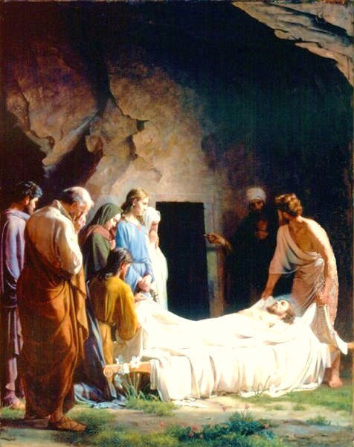
Entombment of Christ
17
Notes:
Joseph of Arimathaea went unto Pilate, and asked for the body of Jesus. Mark wrote, “[And Joseph] bought fine linen, and took him down, and wrapped him in the linen, and laid him in a sepulchre which was hewn out of a rock, and rolled a stone unto the door of the sepulchre. And Mary Magdalene and Mary the mother of Joses beheld where he was laid” (Mark 15:43-46).

Slide 20
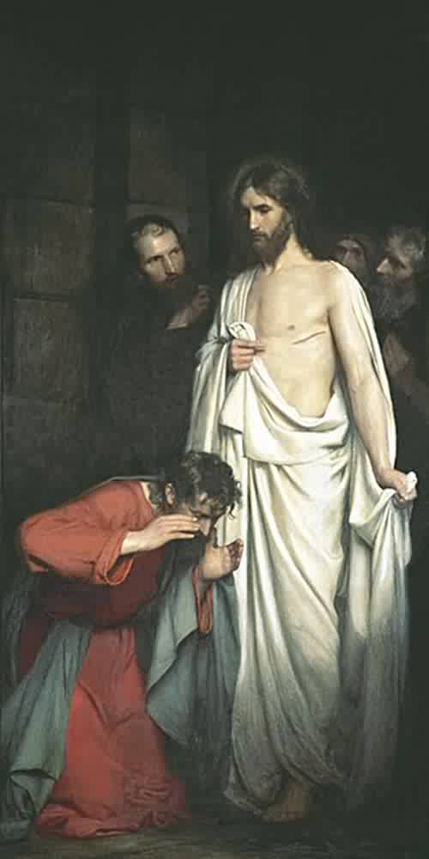
Doubting Thomas
18
Notes:
Said Thomas, “Except I shall see in his hands the print of the nails, and put my finger into the print of the nails, and thrust my hand into his side, I will not believe” (John 20:25). “Though Thomas doubted Jesus’ resurrection until he personally saw the Savior, his strength of character made him willing to face persecution and death with his Lord (John 11:16; 20:19-25)” (“Thomas.” The Guide to the Scriptures. lds.org). Of Thomas’ meeting with the Savior, John wrote, “Then saith [Jesus] to Thomas, Reach hither thy finger, and behold my hands; and reach hither thy hand, and thrust it into my side: and be not faithless, but believing. And Thomas answered and said unto him, My Lord and my God. Jesus saith unto him, Thomas, because thou hast seen me, thou hast believed: blessed are they that have not seen, and yet have believed” (John 20:27-29).

Slide 21
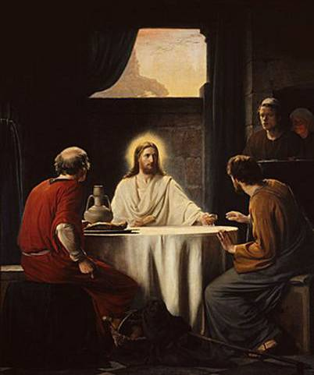
Christ at Emmaus
19
Notes:
Jesus appeared to two of his disciples on the road to Emmaus, but they did not recognize Him as their Savior. Luke later records, “And it came to pass, as he sat at meat with them, he took bread, and blessed it, and brake, and gave to them. And their eyes were opened, and they knew him; and he vanished out of their sight. And they said one to another, Did not our heart burn within us, while he talked with us by the way, and while he opened to us the scriptures? And they rose up the same hour, and returned to Jerusalem . . . Saying, The Lord is risen indeed” (Luke 24:13-34).
We have now reached the end of today’s audiovisual tour. Thank you for joining us today as we commemorate the life and ministry of the Savior as depicted through the paintings of artist Carl Bloch. John wrote, “But these are . . . that ye might believe that Jesus is the Christ, the Son of God; and that believing ye might have life through his name” (John 20:31).

