Slide 1
Student Learning Outcomes Assessment
Notes:
Title Slide before Session Begins.

Slide 2
Introductions
Ross Tomlin
Vice President of Instruction and Student Services
Rod Keller
Dean, Lower Division Collegiate and Developmental Education
Notes:
WELCOME EVERYONE!
We appreciate you coming to our session. We do hope this is a learning opportunity for all of us.
INTRODUCE ourselves.

Slide 3
Outcomes Assessment
Notes:
How many of you are dealing with this topic now at your college?
On a scale of 1-5 (1- you haven't started, 5- you have it all done and implemented), where do you feel you are in fully implementing a viable system? How many at 1? 5? About 2-3? That is where we feel we are at SWOCC.
We want to share with you what we are doing at SWOCC and would love to then have a discussion on where you all are at your colleges, the challenges you are experiencing, and solutions you have found work for you at any stage of the process

Slide 4
Why are We Doing This?
Standard 4.A.3: The institution documents, through an effective, regular, and comprehensive system of assessment of student achievement, that students who complete its educational courses, programs, and degrees, wherever offered and however delivered, achieve identified course, program, and degree learning outcomes. Faculty with teaching responsibilities are responsible for evaluating student achievement of clearly identified learning outcomes.
Notes:
So why are we all working so hard to get this figured out?
Well, Accreditation tells us we have to- focus on Standard 4.A.3 - The institution documents, through an effective, regular, and comprehensive system of assessment of student achievement, that students who complete its educational courses, programs, and degrees, wherever offered and however delivered, achieve identified course, program, and degree learning outcomes. Faculty with teaching responsibilities are responsible for evaluating student achievement of clearly identified learning outcomes.
But most of us have been dealing with this for years now - mention CIA workshop nearly 10 years ago at LCC that focused on this topic. But the NWCCU clearly feels many of us still have a ways to go with this and is not letting go!
And there is a good reason for that. It really is the right thing to do and it benefits students.

Slide 5
Outcomes Assessment and Planning
Outcomes Assessment fits into our Planning process at SWOCC
Success Indicators
Core Theme – Learning and Achievement
Objective- Students demonstrate they have met learning outcomes
Program Viability Process- Outcomes Assessment Rubric for all academic programs
Program Reviews
Notes:
Our college planning process (which of course is mostly tied to Accreditation)
At SWOCC, we have SIs that track how well we are accomplishing our objectives and core themes - creating new SIs for the outcomes assessment work - one for program outcomes assessment and one for Gen Ed outcomes assessment – both tied to our LEARNING AND ACHIEVEMENT CORE THEME, and our LA3 Objective - Students demonstrate they have met learning outcomes.
Program Viability - our PV rubric that is now part of our SLOAP process
What PV is and how the Outcomes part fits into the overall program viability score – PROGRAM VIABILITY RUBRIC ON OUTCOMES ASSESSMENT (refer to handout in packet)
SHARE the program scores from last year to this year.
__________________
Program Reviews – next page

Slide 6
Program Review Template
Notes:
Program Review- Academic and Operational - both tied to budget – PROGRAM REVIEW TEMPLATE (refer to handout in packet)
PR done in fall for past year (look at 4 years of data).
Template includes progress made on Outcomes Assessment
PR due in early Dec with Projects list that includes budget requests for following 2 years.
Deans and VPI review and prioritize budget requests for following year by early January and take back to Faculty for review and feedback.
Budget requests brought to college Budget Committee and ET for approval in late winter.

Slide 7
Outcomes Assessment
GE Outcomes
Discipline Outcomes
Course Outcomes
Student Learning
Notes:
Outcomes Assessment process at SWOCC
Started putting our plan together Fall 2014 in response to Mid-Cycle Evaluation Report that was due March 2015. We knew we had to address all three levels of outcomes assessment and get faculty buy-in.
Looked at other colleges - Accreditation visits are wonderful opportunities
Settled on using a format for our program outcomes assessment and to include curriculum mapping as starting point so it was clear how all three components of outcomes fit together in each academic program and discipline. CTE faculty were very familiar with most of this. LDC faculty not so much.

Slide 8
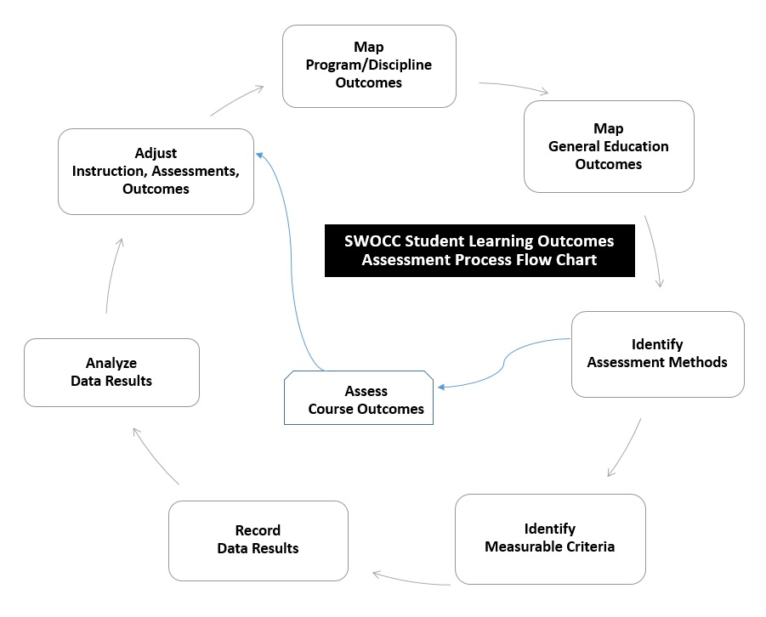
SLOAP
1
2
7
3
6
5
4
Notes:
SHARE Outcomes Assessment Flow Chart – SLOAP FLOW CHART
We developed a Student Learning Outcomes Assessment PLAN (SLOAP) to detail the steps of our process. (If you want a copy, let us know and we will send you a copy).
We started with 3 mapping forms for faculty to use in showing the relationship between the 3 levels of outcomes (more detail coming). MAPPING FORMS (Rod will go into more detail)
We then focused on the Program/Discipline Outcomes measurements first since it was the step being used by another college and it was easier to start with that level – fewer outcomes, more general
The Program/Discipline Outcomes Assessment Report Forms for steps 4-7 (more detail coming up). PROGRAM ASSESSMENT REPORT FORM TEMPLATE (Rod will cover in more detail)
This was all implemented last year in all programs/disciplines.
SHARE DATA on % programs that have completed Mapping forms and Program/Discipline Assessments.
MAPPING forms - _______%
Program Assessment Report Forms- _________% programs have assessed all program outcomes using at least one measurement tool
Now we are expanding to work on General Education Outcomes and Course Outcomes. Rod will give you more detail on that process.
QUESTIONS?

Slide 9
Discipline/Program Outcomes Assessment

Slide 10
Outcomes Assessment
GE Outcomes
Discipline Outcomes
Course Outcomes
Student Learning

Slide 11
1 Discipline Outcomes
Discipline
Outcomes
Department Courses
Assessed
Outcomes
Program

Slide 12
2 Foundation Outcomes
Foundation
Outcomes
Discipline
Outcomes
Level
Outcomes
Program

Slide 13
3 Assessment Methods
Discipline
Outcomes
Course
Outcomes
Assessment
Method
Program

Slide 14
4 Assessment Reports

Slide 15
5-7 Assessment Reports
Outcome Criterion
Tool
Results
Analysis
Plan
Program

Slide 16
Course Outcomes Assessment

Slide 17
Outcomes Assessment
GE Outcomes
Discipline Outcomes
Course Outcomes
Student Learning

Slide 18
1 Discipline Outcomes
Discipline Outcomes
Course Outcomes
Assessment
Methods
Course

Slide 19
2 Foundation Outcomes
Foundation Outcomes
Course Outcomes
Level Outcomes
Course

Slide 20
3 Assessment Methods
Course Outcomes
Course Assignments
Outcomes Assessed
Course

Slide 21
4-7Assessment Reports
Outcome Criterion
Tool
Results
Analysis
Plan
Course

Slide 22
General Student Learning Outcomes

Slide 23
Outcomes Assessment
GE Outcomes
Discipline Outcomes
Course Outcomes
Student Learning

Slide 24
General Student Learning Outcomes
VALUE Rubrics
Multi-State Collaborative
Educational Testing Service

Slide 25
VALUE Rubrics

Slide 26
Communication
Written Communication
Reading
Oral Communication

Slide 27
Computation
Quantitative Literacy
Integrative Learning
Problem Solving

Slide 28
Creative, Critical & Analytical Thinking
Critical Thinking
Creative Thinking
Inquiry and Analysis
Information Literacy

Slide 29
Community, Global Consciousness
Civic Engagement
Intercultural Knowledge and Competence
Global Learning
Ethical Reasoning
Lifelong Learning

Slide 30
Multi-State Collaborative

Slide 31
Multi-State Collaborative
Written Communication
Quantitative Reasoning
Critical Thinking

Slide 32
Educational Testing Service

Slide 33
Educational Testing Service
Written Communication
Quantitative Literacy
Critical Thinking

Slide 34
Outcomes Assessment
GE Outcomes
Discipline Outcomes
Course Outcomes
Student Learning
Notes:
Outcomes Assessment process at SWOCC
Started putting our plan together Fall 2014 in response to Mid-Cycle Evaluation Report that was due March 2015. We knew we had to address all three levels of outcomes assessment and get faculty buy-in.
Looked at other colleges - Accreditation visits are wonderful opportunities
Settled on using a format for our program outcomes assessment and to include curriculum mapping as starting point so it was clear how all three components of outcomes fit together in each academic program and discipline. CTE faculty were very familiar with most of this. LDC faculty not so much.

Slide 35
QUESTIONS?
Discussion

