Slide 1
Southwestern Science
January 25, 2016

Slide 2
Disciplines
5

Slide 3
Disciplines

Slide 4
Degrees/AAOT Majors

Slide 5
Course Development

Slide 6
Science Course
90%

Slide 7
Full-time Faculty
5

Slide 8
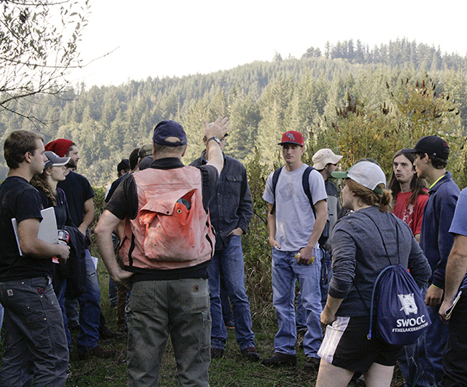
Part-time Faculty
12

Slide 9
Dual Credit Faculty
6

Slide 10
Full-time Faculty FTE
5.5

Slide 11
Part-time Faculty FTE
2.8

Slide 12
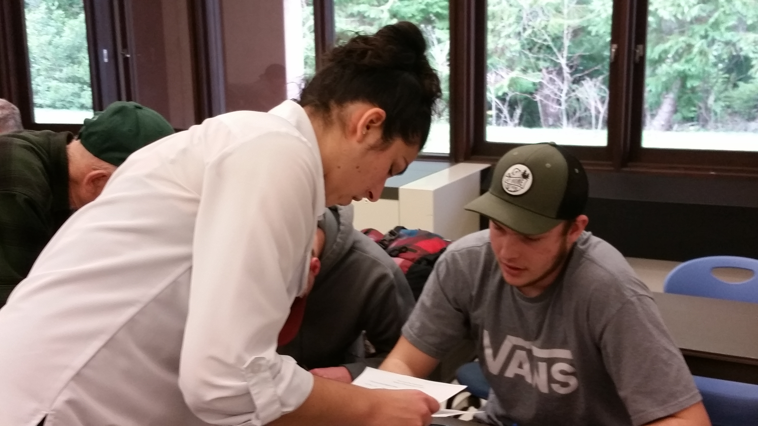
Full- and Part-time Faculty FTE
8.3

Slide 13
Sections
115

Slide 14
Student Enrollments
1924

Slide 15
Class Enrollment
17

Slide 16
Fill Rate
72%

Slide 17
Student FTE
225

Slide 18
Student FTE
$510,750

Slide 19
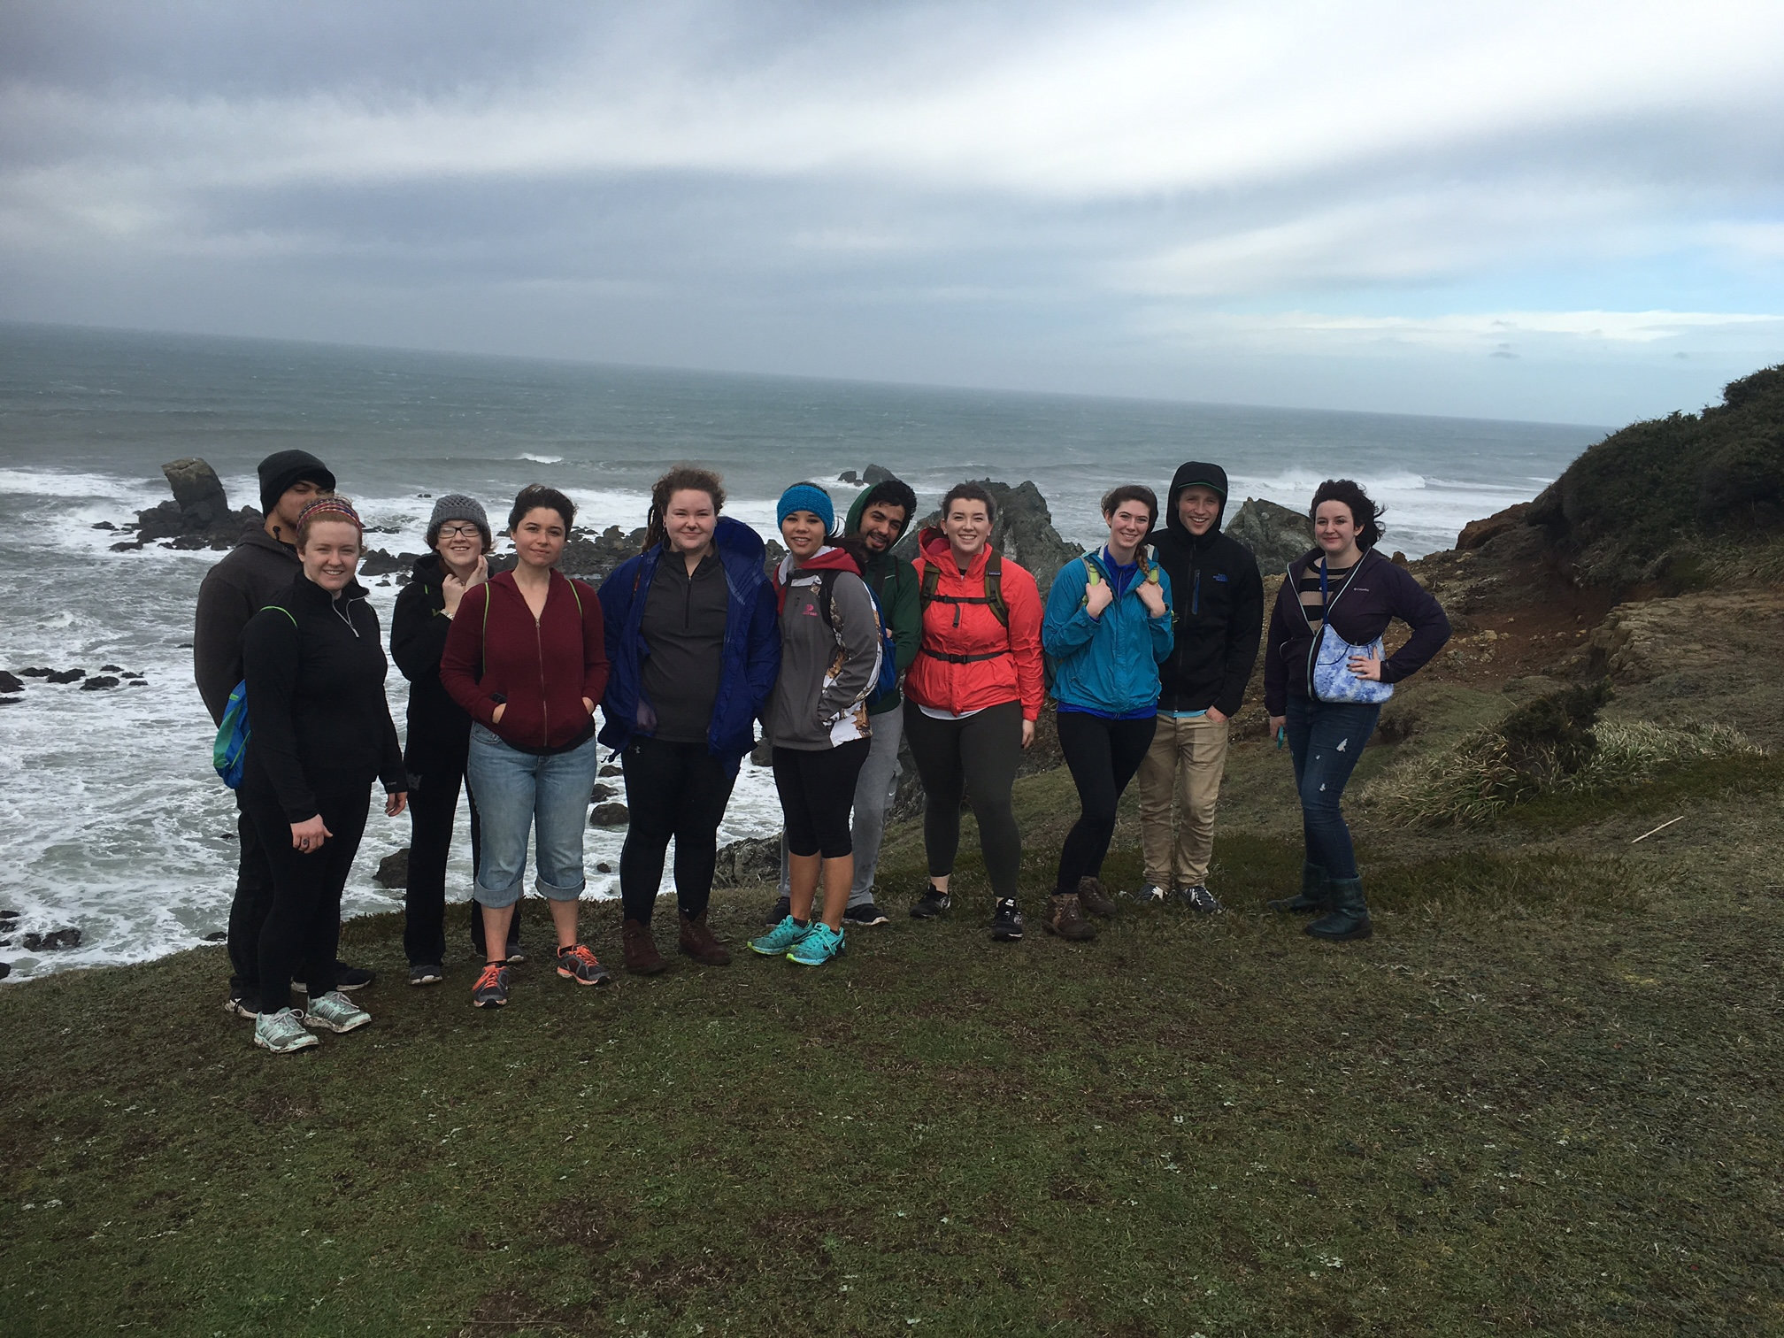
Billing Credits
6280

Slide 20
Billing Credits
$728,480

Slide 21
Student FTE + Billing Credits
$1,220,390

Slide 22
Retention-Completion
78%

Slide 23
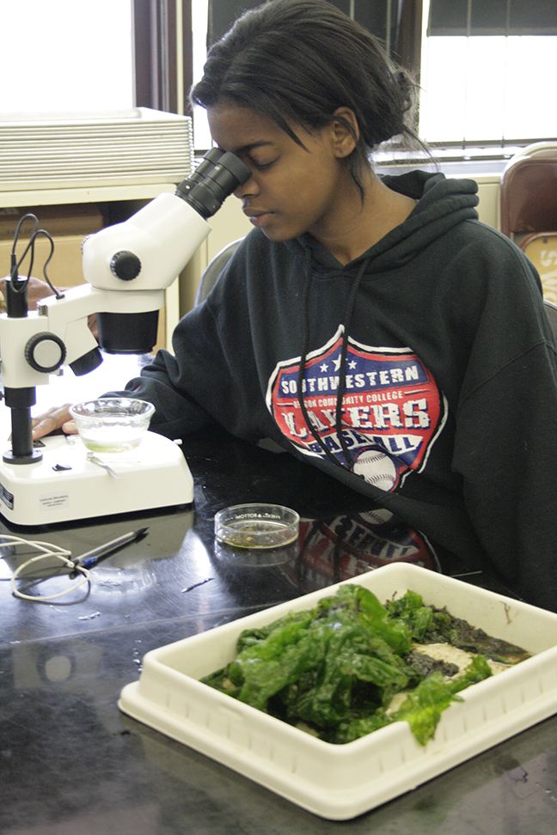
clubs

Slide 24
Geology Lecture Series
6

Slide 25
Geology Lecture Series
~500

Slide 26
Health and Science Building
1

